Slide 1
COVID 19 in Dialysis Wards
Shahrzad Ossareh- MD.
HKC- IUMS
2020/04/30

Slide 2
Introduction
Epidemiologic studies suggest a higher susceptibility of patients with underlying comorbidities such as diabetes, hypertension, cardiovascular disease and elderly.
However due to the new emergence of COV-SARS virus and lack of reliable data on the epidemiology and behaviour of disease in different groups of patients, there is much to be done in this regard, including hemodialysis patients.
In this study we aimed to evaluate the incidence of COVID 19 in a single dialysis center with 180 maintenance hemodialysis patients.

Slide 3
On 20 February 2020 (1st Esfand 1398, Day 0), with official declaration of COVID 19 entry into Iran, we started temperature screening for dialysis patients and personnel and obligatory wearing of surgical masks for personnel throughout their working hours, together with hand-washing for the patients and restrictions on entry of companies for the patients.

Slide 4
On day +3 a 60 YO male patient who complained of fever was assessed by the COVID 19 unit of the hospital who had normal CBC and CXR and was not diagnosed with COVID 19, but turned out to show diarrhea and nausea on the following week, with lymphopenia and positive Chest CT scan and was admitted in the designated COVID 19 ward in the hospital.
Subsequently 4 more patients were diagnosed with COVID 19 during 3 subsequent weeks, one in another hospital (58 yrs old lady), who died after 8 days.

Slide 5
Day +11:
  Surgical mask wearing for all patients,
  Hazmat suits, N95 masks and gloves for personnel
  Hemodialysis shifts reduced to twice a week in about 70% of patients (IDWG<3 kgs and serum K< 5.5 meq/L (before dialysis), to reduce the frequency of transport, contacts and risk of infection.
Cautions were given for overload symptoms and instructions for restrict diet control.
A separate space was designated for dialysis of COVID 19 patients.

Slide 6
Screening was augmented to temperature measurement in addition to complete history for any symptoms of viral infection (cough, soar throat, headache, dyspnea, nausea, vomiting, diarrhea, anosmia,..), history of disease in close contacts, history of recent exposure to COVID 19 patients or travel to epicentres (at that time, the cities of Qom, Rasht and Gorgan).
Food ingestion was forbidden during dialysis, the restaurant was closed and take home food packages were distributed.

Slide 7
Despite these strict isolation measures, the number of symptomatic COVID 19 patients rose to 11 at day 37 and 3 asymptomatic personnel (2 nurses and 1 janitor) became PCR positive during screening.

Slide 8
An emergency state for hemodialysis ward was declared in the hospital and in a meeting with crisis management department.
A screening strategy for all dialysis patients was employed including measurement of complete blood counts (CBC) and white blood cell differentiation, SARS- COV- 2 PCR and Chest CT scan, for all patients before entering the dialysis ward.
The results of chest CT scans were assumed as gold standard and were studied on line by the radiologist and according to the result, patients were designated to be dialysed in different rooms by the head of dialysis ward.

Slide 9
Screening Strategy
The results of CT scan were classified by the radiologist as
  1- normal
  2- weakly suspicious
  2.5- moderately suspicious
  3- highly suspicious
  4- typical
Subsequently after the results of CBC and PCR were obtained in the following days, further decisions for classification of patients were made.
Notes:
nasopharyngeal swab samples of participants were collected for SARS-CoV-2 test with the detection kit (Bioperfectus, Taizhou, China). The ORF1ab gene (nCovORF1ab) and the N gene (nCoV-NP) were used for real-time RT-PCR according to the manufacturer’s instructions.

Slide 10
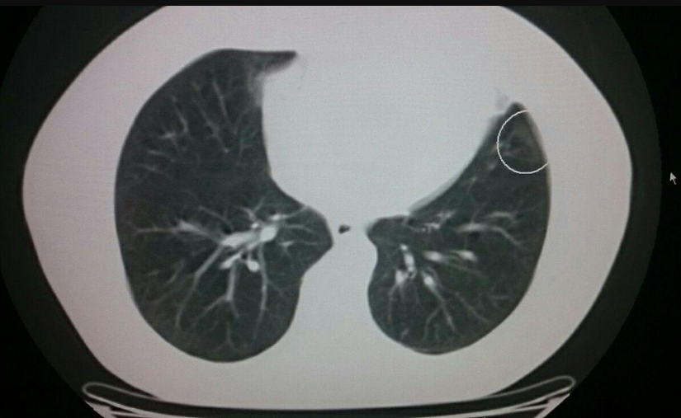
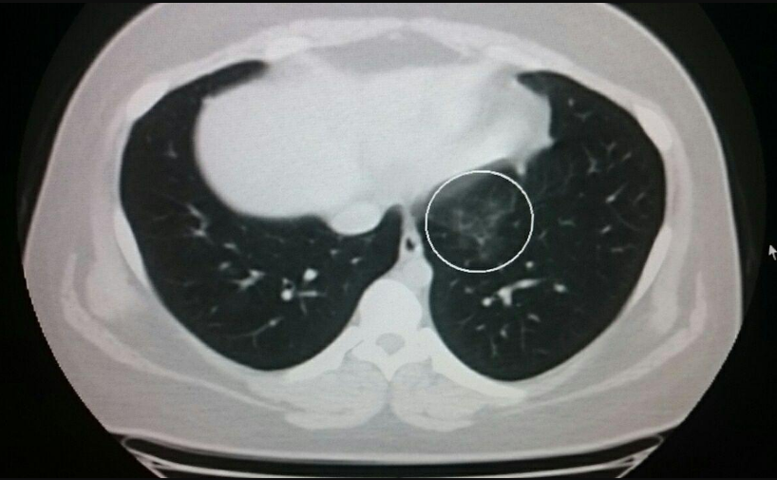
2. Single peripheral GG pleural based lesion
2.5. Single Central GG lesion

Slide 11
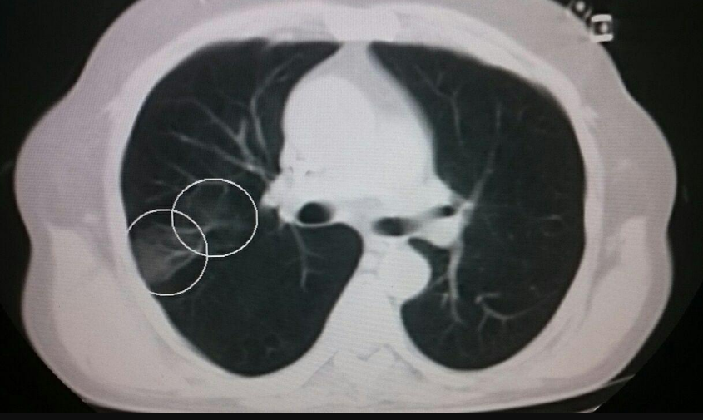
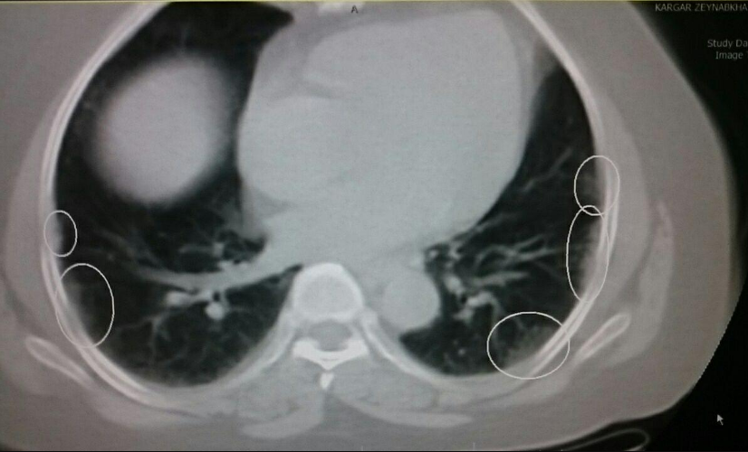
3. Central and peripheral GG lesions
4. Multiple bilateral peripheral GG lesions

Slide 12
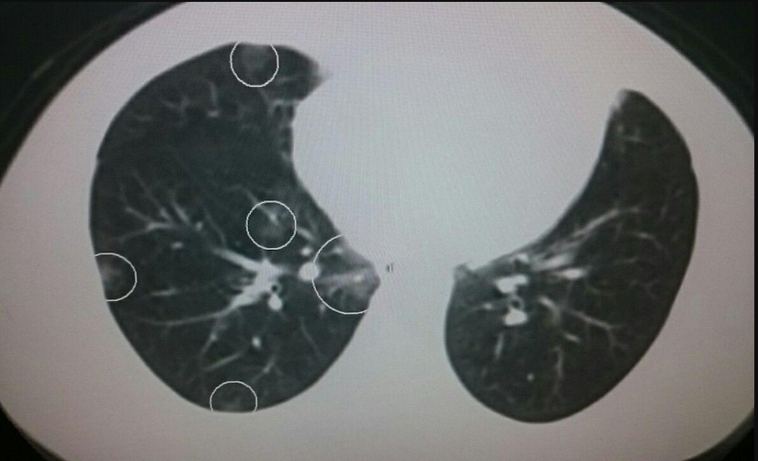
4. Bilateral multiple peripheral and central GG lesions

Slide 13
Characteristics
178 Patients: 68% male (122)
Mean Age: 58.9±16.5 (22-99 yrs)
Dialysis Vintage (months): 143.41±175.199
Primary disease: DM (30%), HTN (12.9%), GN (4.5%)

Slide 14
COVID 19 Evidence (No. %)
No evidence | 111 (62.4%)
CT and/or PCR evidence | 67 (37.6%)
CT only PCR Only Both | 40 (22.5%) 16 (9%) 11 (6.2%)
Positive PCR (No. %)
Negative | 151 (84.8%)
Positive | 27 (15.2%)
Corona Findings in Chest CT Scan (No.%)
Negative | 127 (71.3%)
Positive | 51 (28.7%)
Weakly suspicious Moderately suspicious Highly suspicious Typical | 14 (7.9%) 8 (4.5%) 10 (5.6%) 19 (10.7%)
Detection Time
Before Screening (Symptomatic) | 11 (16.4%)
After Screening | 56 (83.6%)

Slide 15
Lymphopenia
Lymphopenia (<1500) (No. %)
Yes |  |  |  | 92 (51.7%)
No |  |  |  | 80 (44.9%)
Lymphopenia in various states (No. %)
 |  | Negative | CT Only |  | PCR Only | Both CT and PCR |  | Total
 | Yes | 50 | 29 |  | 6 | 7 |  | 92
 | No | 59 | 9 |  | 9 | 3 |  | 80
 | Total | 109 | 38 |  | 15 | 10 |  | 172
P value= 0.005

Slide 16
No difference between rate of infection in
  Male vs. female patients
  DM vs. Non DM patients.
  Hypertensive vs. nohypertensive patients
  Different blood groups
  COVID patients significantly older: 62.6 ±16.2 vs. 56.7±16.3

Slide 17
Chest CT scan grading
 | 1 | 2 | 2.5 | 3 | 4 | Total
PCR - | 111 | 12 | 7 | 9 | 12 | 151
PCR + | 16 | 2 | 1 | 1 | 7 | 27
Total | 127 | 14 | 8 | 10 | 19 | 178

Slide 18
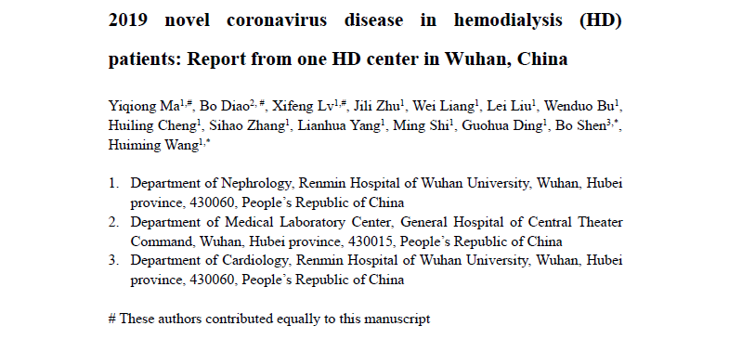


Slide 19
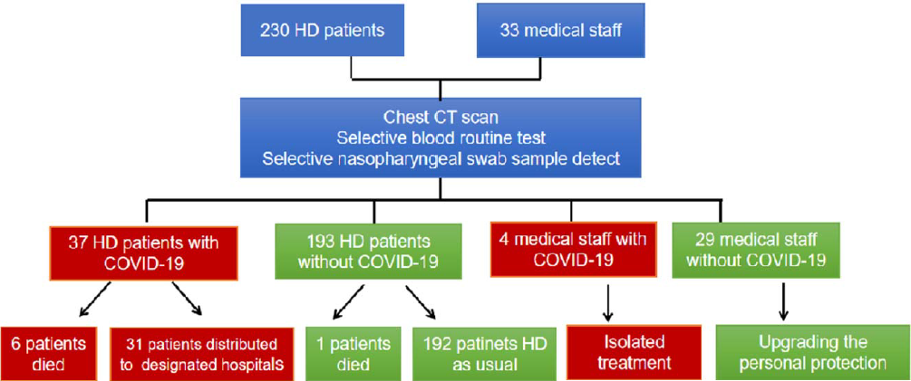

Slide 20
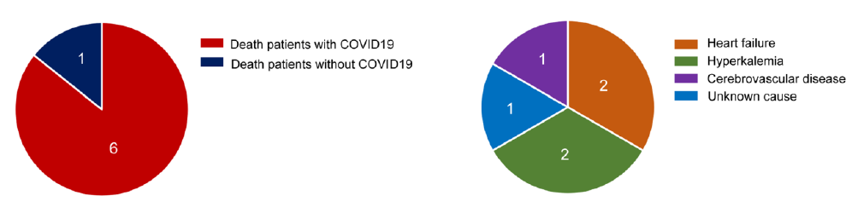

Slide 21
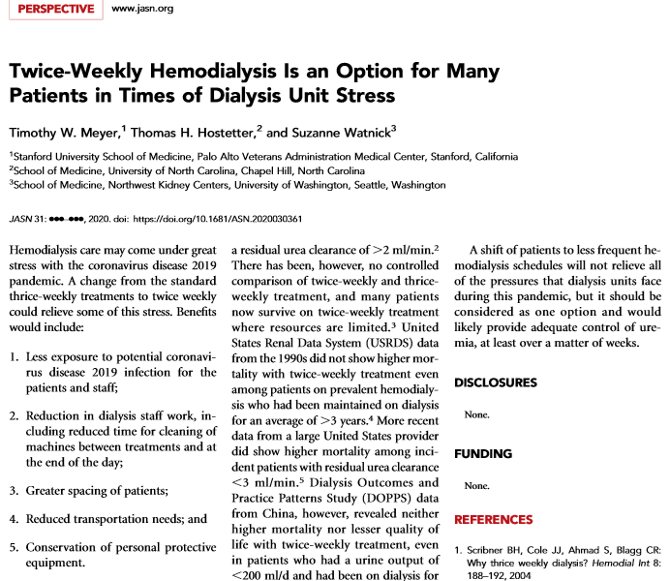

Slide 23
Screening:
  Screening personnel at a single entry to the facility should ask all patients these same questions upon arrival.
  If patients answer yes to any of these questions, they should be required to wear a face mask and directed to a room away from the general waiting room.
  Medically stable patients can wait for evaluation in their private vehicle or outside the dialysis facility.
  Patients with fever, new cough, or dyspnea, and those who have come into contact with people who are infected or traveled through areas with high incidence of infection should be treated as if they are infected with COVID-19 until definitive testing can be completed.
  As testing for the virus becomes more accessible, patients can later be most appropriately cohorted.
  Patients with progressive dyspnea, signs of organ dysfunction, or evidence for adult respiratory distress syndrome should be immediately referred to hospital.
Questions
Testing when available

Slide 24
Patient placement:
Isolate patients with suspected or confirmed COVID-19.
Separate rooms with the door closed may be used if available, except those rooms used for treatment of patients with hepatitis B.
If no separate room is available, patients suspected to have COVID-19 should be cohorted on a designated isolation shift, or dialyzed in a designated COVID-19 facility.
If patients with COVID-19 must be treated at the same time as patients who are asymptomatic, patients who are symptomatic should be treated in a corner or end-of-row station.
At least 6 feet of separation should be maintained between masked patients who are symptomatic and others.
CDC guidance does not require that patients infected with COVID-19 should be treated in an airborne infection isolation room.
Isolation in separate rooms, shifts, end of row station or corner
Separate facilities

Slide 25
Personal protective equipment (PPE):
isolation gowns, gloves, masks, and eye protection
(shields or goggles).
COVID-19 is generally spread by droplets expelled by coughing or sneezing.
Fecal or direct-contact contamination may also occur.
Dialysis staff should employ standard contact and droplet precautions, including isolation gowns, gloves, masks, and eye protection (shields or goggles).
Because PPE likely will need to be deployed for many weeks or months in this current pandemic, care must be taken to establish policies that will not exhaust available supplies of these precious resources.

Slide 26
Environmental disinfection:
Dialysis machine, chair, and all dialysis station surfaces (e.g., the chairside stand) and equipment, including BP cuffs and stethoscopes.
Routine disinfection practices: disinfection wipes for the dialysis machine, chair, and all dialysis station surfaces (e.g., the chairside stand) and equipment, including BP cuffs and stethoscopes.
Care should be taken to carefully wipe all surfaces, including all parts of the dialysis chairs after opening their arms, and allowing them to air-dry.
Although no change in these recommended procedures is needed, disinfection personnel should use the same PPE as caregivers for patients infected with COVID-19.
Another benefit of cohorting patients infected with COVID-19 at the end of the day would be to avoid shift turnover time pressure and allow careful terminal station disinfection.

Slide 27
Corona according to typical CT
Corona according to suspicious CT±PCR
Corona according to positive PCR
1398/12/10: Asgari
1398/12/14: Sagheb Feizi
1398/12/21: Shahriyari
1398/12/21: Laya Ahmadi
1398/12/28: Taloee
1399/01/03 : Akbar Salehi
1399/01/05: Seyed reza Ziayee
1399/01/06: Mizani Ali
1399/01/06: Nazemian
1399/01/07: Afshari
1399/01/07: Sarhadi

